Slide 1


Naïve QUBO Formulations
Jonas Nüßlein, Sebastian Zielinski, Sebastian Feld, Claudia Linnhoff-Popien
IEEE Quantum Week (IEEE QCE’23)
September 18, 2023

Slide 2
Agenda
Quantum Annealing in a Nutshell
QGM vs. AQC
QUBO and TSP
Satisfiability
PyQUBO
Conclusion

Slide 3
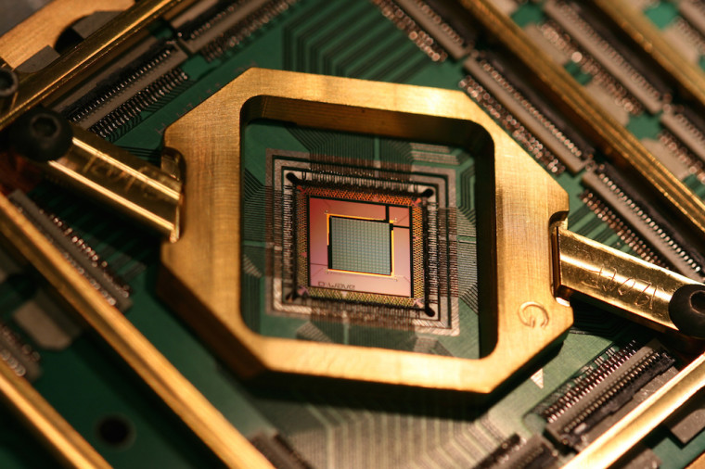
I. Quantum Annealing in a Nutshell
cdn.neowin.com/news/images/uploaded/2020/09/1601305839_d-wave_story.jpg

Slide 4






Quantum Computing
Quantum Gate Model
Quantum Annealing
…
Notes:
https://insidehpc.com/wp-content/uploads/2015/06/d-wave-300x300.jpg
https://www-03.ibm.com/press/us/en/photo/20190.wss
https://upload.wikimedia.org/wikipedia/commons/thumb/2/2f/Google_2015_logo.svg/2000px-Google_2015_logo.svg.png
http://ncmedia.azureedge.net/ncmedia/2014/10/MSFT_logo_rgb_C-Gray.png

Slide 5
Quantum Annealing
Best solution
Quality of solution
All possible solutions

Slide 6






Portfolio Optimization
 |  |  |  |  | …
? | ? | ? | ? | ? | … | ?
Spend budget, minimize risk, maximize outcome

Slide 7
Portfolio Optimization
 |  |  |  |  | …
Buy |  |  | Buy | Buy | …
Spend budget, minimize risk, maximize outcome

Slide 8






Qubits represent stocks
…
…
…
…
…
…
…
…
…
…

Slide 9
Initialize qubits in superposition
?
?
?
?
?
?
?
?
?
?
?
?
?
?
?
?

Slide 10
Formulate constraints
?
?
?
?
?
?
?
?
?
?
?
?
?
?
?
?

Slide 11
Anneal to optimal solution
Y
Y
Y
Y
Y
N
N
Y
Y
Y
N
Y
N
Y
Y
N

Slide 12
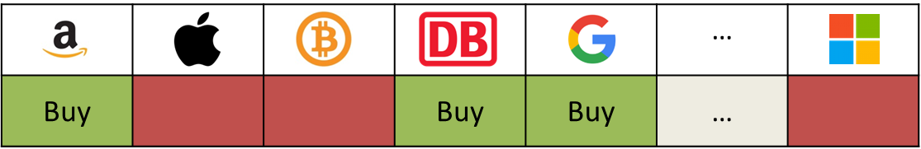
Quantum Annealing
Best solution
Quality of solution
All possible solutions

Slide 13
II. QGM vs. AQC
cdn.neowin.com/news/images/uploaded/2020/09/1601305839_d-wave_story.jpg

Slide 14
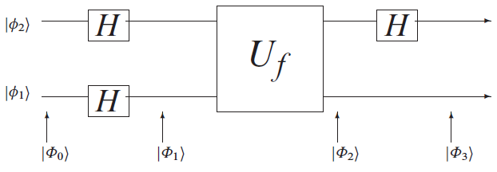
Quantum Gate Model
Source: McGeoch

Slide 15
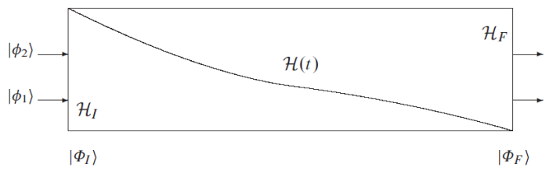
Adiabatic Quantum Computation
Source: McGeoch

Slide 16
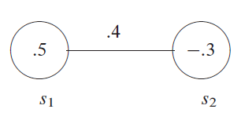
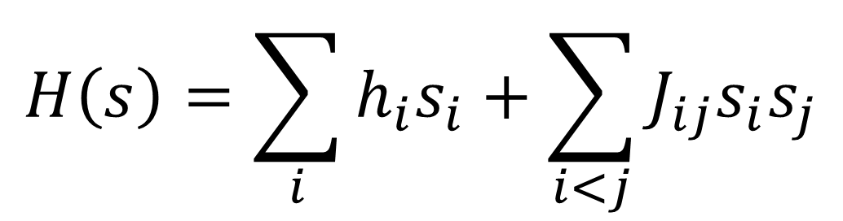
Ising Model
Source: McGeoch
$$H\left(s\right)=\sum_{i}{h_{i}s_{i}}+\sum_{i<j}{J_{ij}s_{i}s_{j}}$$

Slide 17
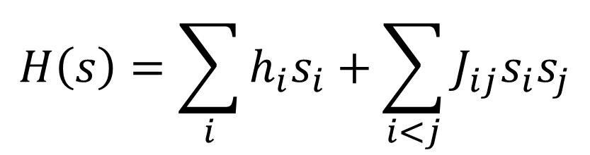
Quantum Annealing
Source: McGeoch
Best solution
Quality of solution
$$H\left(s\right)=\sum_{i}{h_{i}s_{i}}+\sum_{i<j}{J_{ij}s_{i}s_{j}}$$
All possible solutions

Slide 18
III. QUBO and TSP
cdn.neowin.com/news/images/uploaded/2020/09/1601305839_d-wave_story.jpg

Slide 19

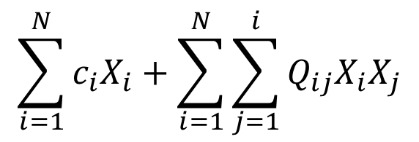
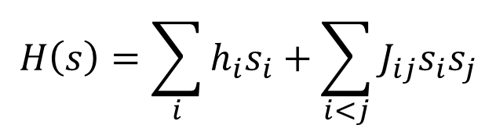

QUBO
Ising Model
Quadratic Unconstrained Binary Optimization
$$H\left(s\right)=\sum_{i}{h_{i}s_{i}}+\sum_{i<j}{J_{ij}s_{i}s_{j}}$$
$$\sum_{i=1}^{N}{c_{i}X_{i}}+\sum_{i=1}^{N}{\sum_{j=1}^{i}{Q_{ij}X_{i}X_{j}}}$$
$$X_{i}∈\left\{0,1\right\}$$
$$c_{i}, Q_{ij}∈ℝ$$

Slide 20
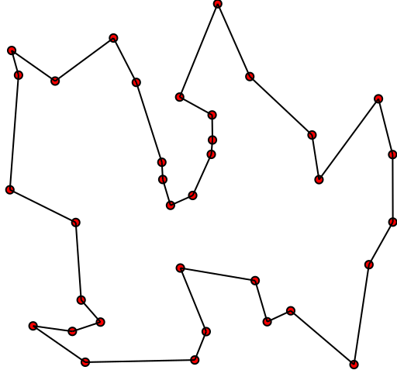
Travelling Salesman Problem
Source: Wikipedia
Given a list of cities and the distances between each pair of cities,
what is the shortest possible route that visits each city exactly once and returns to the origin city?

Slide 21
The Good, the Bad and the Ugly
D
E
D
E
D
E
C
F
C
F
C
F
B
G
B
G
B
G
A
H
A
H
A
H

Slide 22
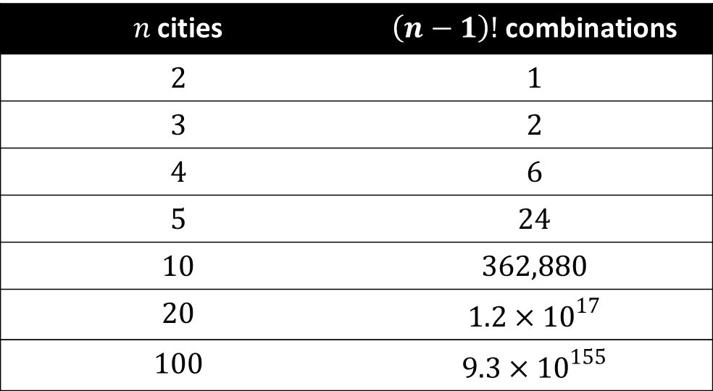
Combinatorial Optimization
$n$ cities | $\left(n−1\right)!$ combinations
$$2$$ | $$1$$
$$3$$ | $$2$$
$$4$$ | $$6$$
$$5$$ | $$24$$
$$10$$ | $$362,880$$
$$20$$ | $$1.2×{10}^{17}$$
$$100$$ | $$9.3×{10}^{155}$$

Slide 23
Quantum Annealing (QA)
Quality of solution
All possible solutions

Slide 24
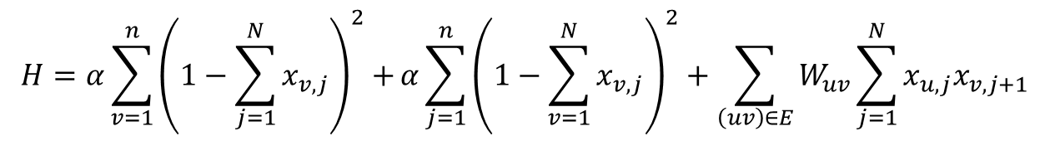

TSP as Ising Formulation
Source: http://arxiv.org/pdf/1302.5843.pdf
$$H=α\sum_{v=1}^{n}{{\left(1−\sum_{j=1}^{N}{x_{v,j}}\right)}^{2}+}α\sum_{j=1}^{n}{{\left(1−\sum_{v=1}^{N}{x_{v,j}}\right)}^{2}}+\sum_{\left(uv\right)∈E}{W_{uv}\sum_{j=1}^{N}{x_{u,j}x_{v,j+1}}}$$
D
E
C
F
B
G
A
H
Given graph $G=\left(V,E\right)$ with edge weights $W_{uv}$,
find hamiltonian cycle with minimum sum of edge weights

Slide 25
TSP as Ising Formulation
$$H=α\sum_{v=1}^{n}{{\left(1−\sum_{j=1}^{N}{x_{v,j}}\right)}^{2}+}α\sum_{j=1}^{n}{{\left(1−\sum_{v=1}^{N}{x_{v,j}}\right)}^{2}}+\sum_{\left(uv\right)∈E}{W_{uv}\sum_{j=1}^{N}{x_{u,j}x_{v,j+1}}}$$
D
E
 | A1 | A2 | A3 | A4 | B1 | B2 | B3 | B4 | C1 | C2 | C3 | C4
A1
A2
A3
A4
B1
B2
B3
B4
C
F
B
G
A
H

Slide 26
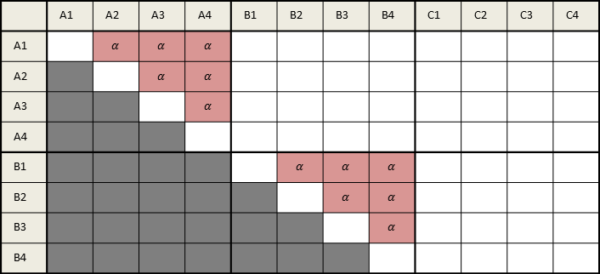
TSP as Ising Formulation
$$H=α\sum_{v=1}^{n}{{\left(1−\sum_{j=1}^{N}{x_{v,j}}\right)}^{2}+}α\sum_{j=1}^{n}{{\left(1−\sum_{v=1}^{N}{x_{v,j}}\right)}^{2}}+\sum_{\left(uv\right)∈E}{W_{uv}\sum_{j=1}^{N}{x_{u,j}x_{v,j+1}}}$$
 | A1 | A2 | A3 | A4 | B1 | B2 | B3 | B4 | C1 | C2 | C3 | C4
A1 |  | $$α$$ | $$α$$ | $$α$$
A2 |  |  | $$α$$ | $$α$$
A3 |  |  |  | $$α$$
A4
B1 |  |  |  |  |  | $$α$$ | $$α$$ | $$α$$
B2 |  |  |  |  |  |  | $$α$$ | $$α$$
B3 |  |  |  |  |  |  |  | $$α$$
B4
Every vertex can only appear once in a circle

Slide 27
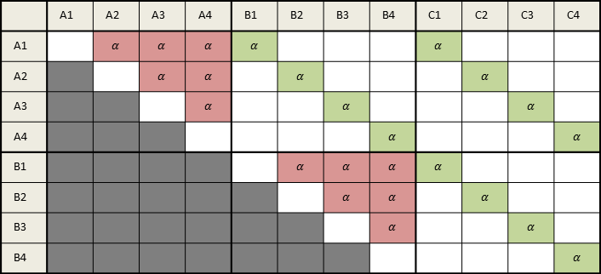
TSP as Ising Formulation
$$H=α\sum_{v=1}^{n}{{\left(1−\sum_{j=1}^{N}{x_{v,j}}\right)}^{2}+}α\sum_{j=1}^{n}{{\left(1−\sum_{v=1}^{N}{x_{v,j}}\right)}^{2}}+\sum_{\left(uv\right)∈E}{W_{uv}\sum_{j=1}^{N}{x_{u,j}x_{v,j+1}}}$$
 | A1 | A2 | A3 | A4 | B1 | B2 | B3 | B4 | C1 | C2 | C3 | C4
A1 |  | $$α$$ | $$α$$ | $$α$$ | $$α$$ |  |  |  | $$α$$
A2 |  |  | $$α$$ | $$α$$ |  | $$α$$ |  |  |  | $$α$$
A3 |  |  |  | $$α$$ |  |  | $$α$$ |  |  |  | $$α$$
A4 |  |  |  |  |  |  |  | $$α$$ |  |  |  | $$α$$
B1 |  |  |  |  |  | $$α$$ | $$α$$ | $$α$$ | $$α$$
B2 |  |  |  |  |  |  | $$α$$ | $$α$$ |  | $$α$$
B3 |  |  |  |  |  |  |  | $$α$$ |  |  | $$α$$
B4 |  |  |  |  |  |  |  |  |  |  |  | $$α$$
There must be a $j^{th}$ node in the cycle for each $j$

Slide 28
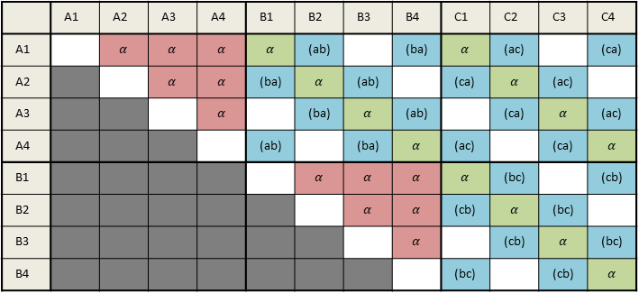
TSP as Ising Formulation
$$H=α\sum_{v=1}^{n}{{\left(1−\sum_{j=1}^{N}{x_{v,j}}\right)}^{2}+}α\sum_{j=1}^{n}{{\left(1−\sum_{v=1}^{N}{x_{v,j}}\right)}^{2}}+\sum_{\left(uv\right)∈E}{W_{uv}\sum_{j=1}^{N}{x_{u,j}x_{v,j+1}}}$$
 | A1 | A2 | A3 | A4 | B1 | B2 | B3 | B4 | C1 | C2 | C3 | C4
A1 |  | $$α$$ | $$α$$ | $$α$$ | $$α$$ | (ab) |  | (ba) | $$α$$ | (ac) |  | (ca)
A2 |  |  | $$α$$ | $$α$$ | (ba) | $$α$$ | (ab) |  | (ca) | $$α$$ | (ac)
A3 |  |  |  | $$α$$ |  | (ba) | $$α$$ | (ab) |  | (ca) | $$α$$ | (ac)
A4 |  |  |  |  | (ab) |  | (ba) | $$α$$ | (ac) |  | (ca) | $$α$$
B1 |  |  |  |  |  | $$α$$ | $$α$$ | $$α$$ | $$α$$ | (bc) |  | (cb)
B2 |  |  |  |  |  |  | $$α$$ | $$α$$ | (cb) | $$α$$ | (bc)
B3 |  |  |  |  |  |  |  | $$α$$ |  | (cb) | $$α$$ | (bc)
B4 |  |  |  |  |  |  |  |  | (bc) |  | (cb) | $$α$$
If the edge is part of the cycle, apply the edge weight

Slide 29
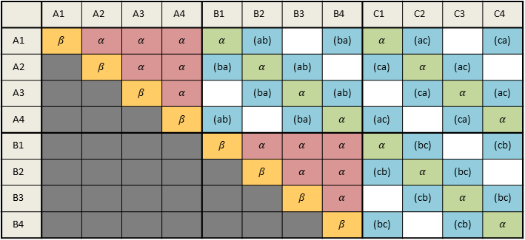
TSP as Ising Formulation
$$H=α\sum_{v=1}^{n}{{\left(1−\sum_{j=1}^{N}{x_{v,j}}\right)}^{2}+}α\sum_{j=1}^{n}{{\left(1−\sum_{v=1}^{N}{x_{v,j}}\right)}^{2}}+\sum_{\left(uv\right)∈E}{W_{uv}\sum_{j=1}^{N}{x_{u,j}x_{v,j+1}}}$$
 | A1 | A2 | A3 | A4 | B1 | B2 | B3 | B4 | C1 | C2 | C3 | C4
A1 | $$β$$ | $$α$$ | $$α$$ | $$α$$ | $$α$$ | (ab) |  | (ba) | $$α$$ | (ac) |  | (ca)
A2 |  | $$β$$ | $$α$$ | $$α$$ | (ba) | $$α$$ | (ab) |  | (ca) | $$α$$ | (ac)
A3 |  |  | $$β$$ | $$α$$ |  | (ba) | $$α$$ | (ab) |  | (ca) | $$α$$ | (ac)
A4 |  |  |  | $$β$$ | (ab) |  | (ba) | $$α$$ | (ac) |  | (ca) | $$α$$
B1 |  |  |  |  | $$β$$ | $$α$$ | $$α$$ | $$α$$ | $$α$$ | (bc) |  | (cb)
B2 |  |  |  |  |  | $$β$$ | $$α$$ | $$α$$ | (cb) | $$α$$ | (bc)
B3 |  |  |  |  |  |  | $$β$$ | $$α$$ |  | (cb) | $$α$$ | (bc)
B4 |  |  |  |  |  |  |  | $$β$$ | (bc) |  | (cb) | $$α$$
Reward setting a qubit to $1$ with negative value in diagonal

Slide 30
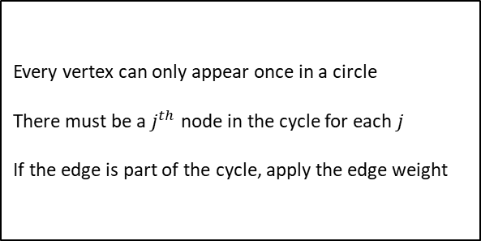
TSP as Ising Formulation
$$H=α\sum_{v=1}^{n}{{\left(1−\sum_{j=1}^{N}{x_{v,j}}\right)}^{2}+}α\sum_{j=1}^{n}{{\left(1−\sum_{v=1}^{N}{x_{v,j}}\right)}^{2}}+\sum_{\left(uv\right)∈E}{W_{uv}\sum_{j=1}^{N}{x_{u,j}x_{v,j+1}}}$$
Every vertex can only appear once in a circle
There must be a $j^{th}$ node in the cycle for each $j$
If the edge is part of the cycle, apply the edge weight

Slide 31
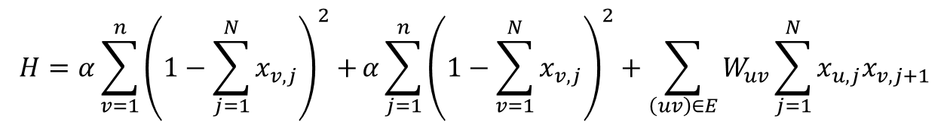
Quantum Annealing (QA)
$$H=α\sum_{v=1}^{n}{{\left(1−\sum_{j=1}^{N}{x_{v,j}}\right)}^{2}+}α\sum_{j=1}^{n}{{\left(1−\sum_{v=1}^{N}{x_{v,j}}\right)}^{2}}+\sum_{\left(uv\right)∈E}{W_{uv}\sum_{j=1}^{N}{x_{u,j}x_{v,j+1}}}$$
Quality of solution
All possible solutions

Slide 32
IV. Satisfiability
cdn.neowin.com/news/images/uploaded/2020/09/1601305839_d-wave_story.jpg

Slide 33
3SAT-to-QUBO transformation (Choi)
Step 1: Build a graph structure for each clause
$${Φ= (x}_{1}∨x_{2}∨x_{3})∧(−x_{1}∨x_{2}∨x_{4})∧(x_{1}∨−x_{2}∨x_{3})$$
X_{1,1}
X_{1,2}
X_{1,3}
X_{2,1}
X_{3,1}
X_{2,2}
X_{4,2}
X_{2,3}
X_{3,3}

Slide 34
3SAT-to-QUBO transformation (Choi)
Step 2: Interconnect conflicting literals from different clauses
$${Φ= (x}_{1}∨x_{2}∨x_{3})∧(−x_{1}∨x_{2}∨x_{4})∧(x_{1}∨−x_{2}∨x_{3})$$
X_{1,1}
X_{1,2}
X_{1,3}
X_{2,1}
X_{3,1}
X_{2,2}
X_{4,2}
X_{2,3}
X_{3,3}

Slide 35
3SAT-to-QUBO transformation (Choi)
Step 3: Add weights
$${Φ= (x}_{1}∨x_{2}∨x_{3})∧(−x_{1}∨x_{2}∨x_{4})∧(x_{1}∨−x_{2}∨x_{3})$$
-1
-1
-1
X_{1,1}
3
X_{1,2}
3
X_{1,3}
3
3
3
3
3
3
X_{2,1}
3
X_{3,1}
X_{2,2}
3
X_{4,2}
X_{2,3}
3
X_{3,3}
-1
-1
-1
-1
-1
-1
3
3

Slide 36
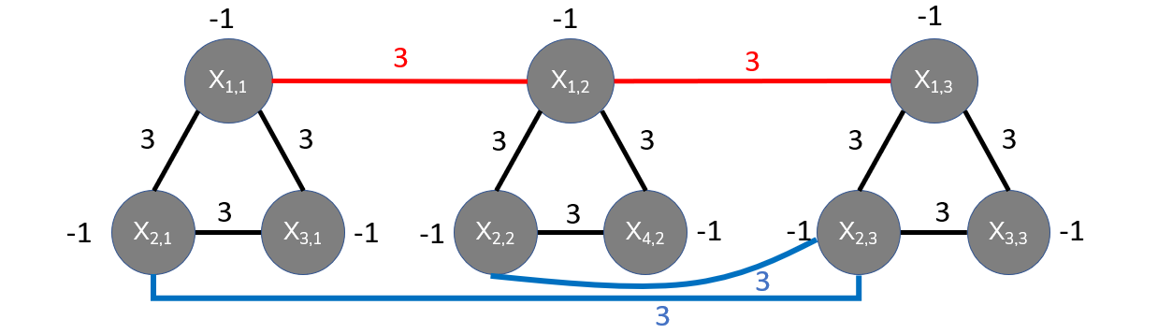
3SAT-to-QUBO transformation (Choi)
Step 4: Rewrite as QUBO
$${Φ= (x}_{1}∨x_{2}∨x_{3})∧(−x_{1}∨x_{2}∨x_{4})∧(x_{1}∨−x_{2}∨x_{3})$$
 | X_{1,1} | X_{2,1} | X_{3,1} | X_{1,2} | X_{2,2} | X_{4,2} | X_{1,3} | X_{2,3} | X_{3,3}
X_{1,1} | -1 | 3 | 3 | 3
X_{2,1} |  | -1 | 3 |  |  |  |  | 3
X_{3,1} |  |  | -1
X_{1,2} |  |  |  | -1 | 3 | 3 | 3
X_{2,2} |  |  |  |  | -1 | 3 |  | 3
X_{4,2} |  |  |  |  |  | -1
X_{1,3} |  |  |  |  |  |  | -1 | 3 | 3
X_{2,3} |  |  |  |  |  |  |  | -1 | 3
X_{3,3} |  |  |  |  |  |  |  |  | -1

Slide 37
3SAT-to-QUBO transformation (Choi)
Solutions: Independent sets minimizing node sums
$${Φ= (x}_{1}∨x_{2}∨x_{3})∧(−x_{1}∨x_{2}∨x_{4})∧(x_{1}∨−x_{2}∨x_{3})$$
-1
-1
-1
X_{1,1}
3
X_{1,2}
3
X_{1,3}
3
3
3
3
3
3
X_{2,1}
3
X_{3,1}
X_{2,2}
3
X_{4,2}
X_{2,3}
3
X_{3,3}
-1
-1
-1
-1
-1
-1
3
3
Notes:
X1 true, x2 true, x3 true
X4 ist nicht teil von MIS, daher kein wert

Slide 38
V. PyQUBO
cdn.neowin.com/news/images/uploaded/2020/09/1601305839_d-wave_story.jpg

Slide 39
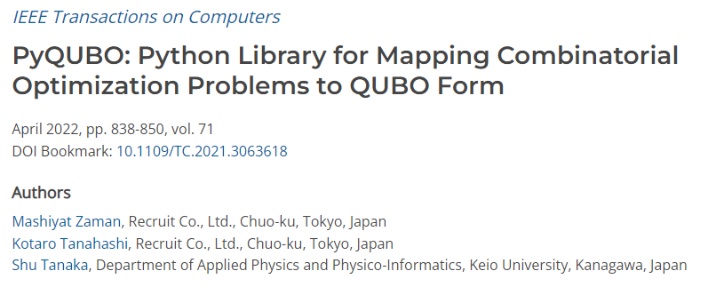
PyQUBO
computer.org/csdl/journal/tc/2022/04/09369010/1rFw6CzYBP2
Open-source Python library for constructing QUBOs matrices from objective functions and constraints of optimization problems
Features abstraction of expressions and extensibility of the program to create QUBO instances and Ising models
Examples: number partitioning problem, knapsack problem, graph coloring problem, and integer factorization using a binary multiplier

Slide 40
VI. Conclusion
cdn.neowin.com/news/images/uploaded/2020/09/1601305839_d-wave_story.jpg

Slide 41





mcmbuzz.com/wp-content/uploads/2014/01/bttf1logo.jpg
$$\underset{→}{?}$$
$$\sum_{i=1}^{N}{c_{i}X_{i}}+\sum_{i=1}^{N}{\sum_{j=1}^{i}{Q_{ij}X_{i}X_{j}}}$$
$$X_{i}∈\left\{0,1\right\}$$
$$c_{i}, Q_{ij}∈ℝ$$
Notes:
http://www.mcmbuzz.com/wp-content/uploads/2014/01/bttf1logo.jpg

Slide 42
Naïve QUBO Formulations
Jonas Nüßlein, Sebastian Zielinski, Sebastian Feld, Claudia Linnhoff-Popien
Thank you!
IEEE Quantum Week (IEEE QCE’23)
September 18, 2023

